Slide 1


AI DEFECT DETECTION SYSTEM
AI
SUPERVISED BY
DR. AHMED SHAWKY MOUSSA
TA. ANDREW MAHER
IMPLEMENTED BY
AHMED GAMAL 20190021
AHMED ADEL 20190042
HASNAA MOUNIR 20190180
ZEYAD MAHER 20190224
MENNATULLAH RASHED 20190554

Slide 2
Table of contents
01
Introduction
03
Final Stage
02
Initial stage
04
Mobile Application
01
03
05
02
05
Conclusion
04

Slide 3
01
Introduction
A Brief Introduction to the Project Concept

Slide 4
Introduction
As the American Society of Quality reports [1], many organizations have quality-related costs of up to 40% of their total production revenue.
40%
[1]
https://asq.org/quality-resources/cost-of-quality#:~:text=Many%20organizations%20will%20have%20true,10%2D15%25%20of%20operations.

Slide 5

Main Problems
Manual quality inspection is a step in ensuring the success and sustainability of a business.
+
Decreased efficiency
Wasted resources
Micro Defects

Slide 6

Project Idea
IDEA
SCOPE
developing a more efficient and accurate way for
quality inspection.
Focusing on the
manufacturing industry.
By detecting defective products.
Using
AI, deep learning, and computer vision

Slide 7
Expected Benefits
One application with a big potential to benefit from AI – Computer vision is Automated quality control system.
Cost
Quality
Reporting
Localization
9

Slide 8







SOFTWARE
Python
tensorflow
Flutter
Flask

Slide 9
02
Implementation stages
Clarifying the various stages, we have passed

Slide 10

Objective
Develop a model capable of detecting the state of a product and determining whether it is good or defective.
Create a portable version runs on
Embedded device.

Slide 11
AI System Components - Hierarchical Structure
AI Defect Detection System
Object Detection
Object Calssification
Camera Device
Model Maker
MobileNet SSD
Simple CNN Architecture
VGG-16

Slide 12
2.1
Initial Stage
Model Exploration and Observations

Slide 13
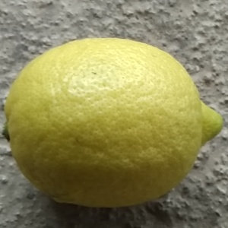
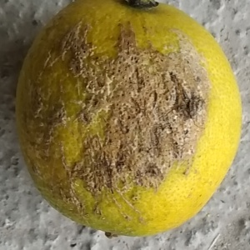
Initial Stage Dataset
A dataset of 1,600 images for lemons was acquired, containing both good and rotten samples.
Non-defect
Defect

Slide 14
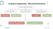
Initial Stage Object Detection - Model Maker
A library provided by TensorFlow that simplifies the process of building machine learning models.
It offers pre-trained models and tools for training and deploying custom models.

Slide 15
Initial Stage Object Classification
A simple CNN architecture consisting of 5 layers is used in the model.
Input
Conv2D
Max Pooling
Dense
Dense
Output

Slide 16
Initial Stage Observations
Dataset’s size affected the accuracy of the 2 models
Observation
Object detection model need to be faster
Inadequate for large datasets and multiple classes

Slide 17
2.2
Final Stage
Model Enhancement and Optimization

Slide 18
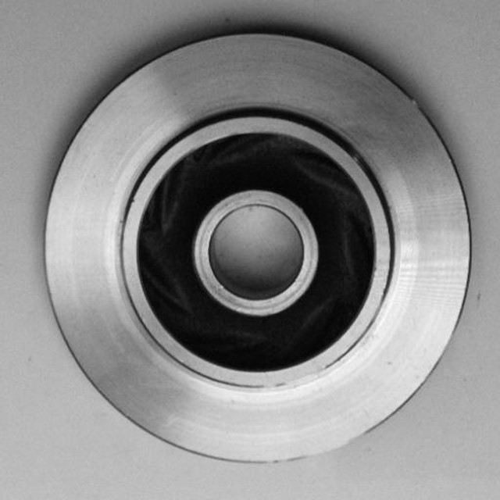
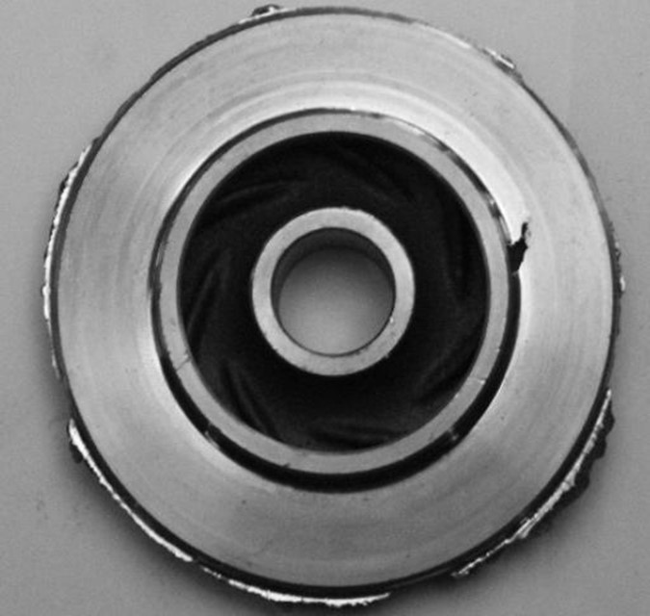
Final Stage Dataset
A dataset of 11,000 images for Casting Product was acquired, containing both good and defected samples.
Characteristic : Small-Sized Defects
Non-defect
Defect

Slide 19
Final Stage Object Detection - MobileNet SSD
MobileNet is A CNN architecture made by TensorFlow for building object detection models.
MobileNet
SSD is Single Shot Detector uses MobileNet architecture as a backbone producing fast detection.
SSD

Slide 20


Advantages of MobileNet SSD
Balance between speed and accuracy
2.0
Optimized for resource-constrained environments, offering a balance between speed and accuracy.
Lightweight model
1.0
Lightweight model for embedded devices or mobile platforms.

Slide 21
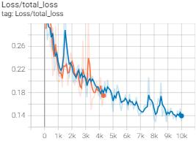
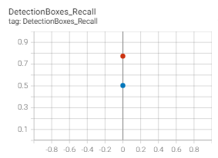
Line Chart for Object Detection Model Accuracy
Latest Training 10,000 Steps
Old Training 4,000 Steps

Slide 22
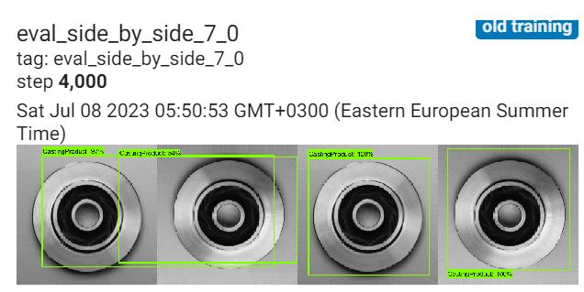
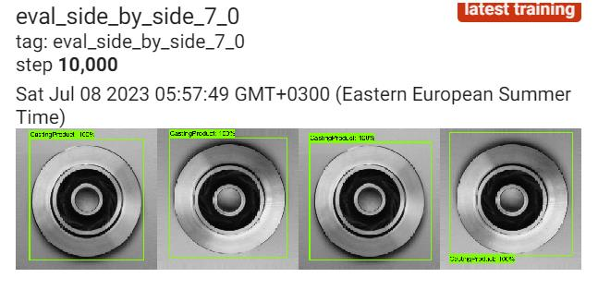
Evaluation
Old Training
Latest Training

Slide 23
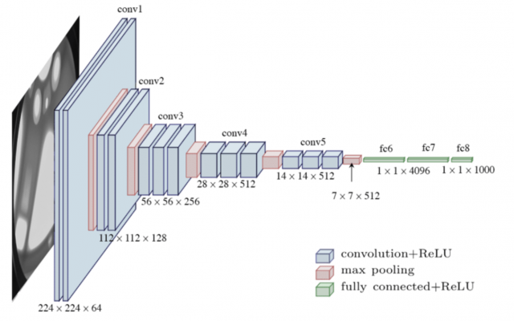
Final Stage Object Classification - VGG16
Visual Geometry Group (VGG-16)
Successful CNN Architecture, Well Understand, acceptable to implement. using 13 Convolution + 3 fully connected + 5 max-pooling layers

Slide 24
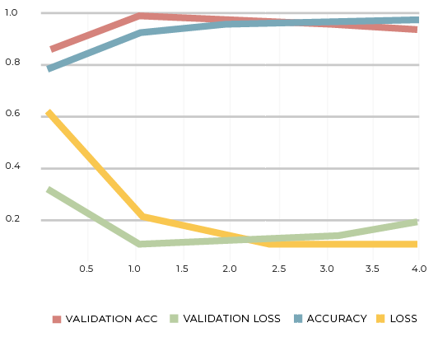
Line Chart for VGG-16 Model Accuracy

Slide 25
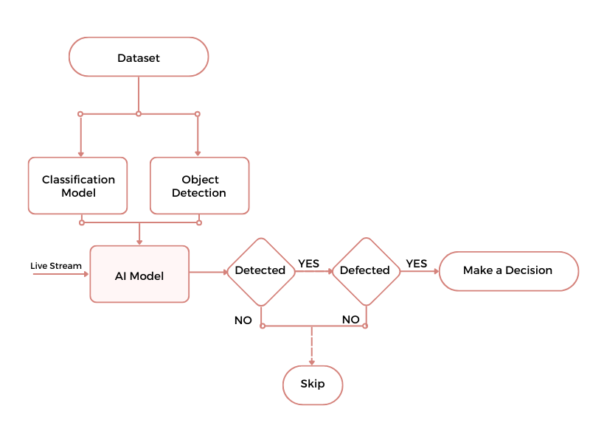

System Architecture
Output Defected

Slide 26
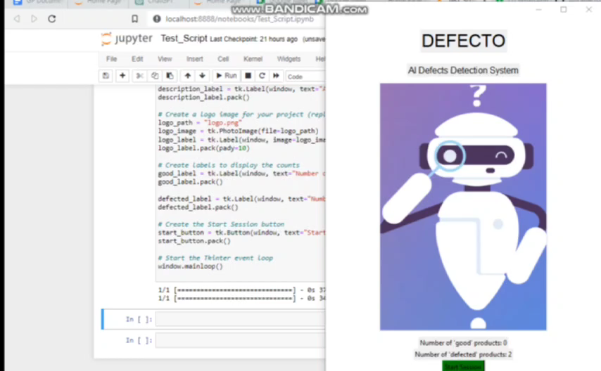
AI Model Demo

Slide 27
04
Mobile App
Mobile app integration

Slide 28


Mobile APP
Embedded System Simulation
Movable System
The mobile app was developed to simulate limited computational resources in the Embedded systems.
Fixed products like solar energy cells are scanned using drones

Slide 29
Mobile APP
Develop an interface to the system using Flutter and integrate our AI Model the model using TFlite.
TFLite is a TensorFlow’s Package for Using AI models on mobile and embedded devices.
Observation : Converting the model to TFLite reduced the accuracy of it.

Slide 30
Mobile APP
Develop an interface to the system using Flutter and integrate our AI model using Flask and the server Ngrok.
Observation Slight delay on overall system speed
Classification model accuracy was as expected

Slide 31

Mobile App Demo

Slide 32
05
Conclusion
A conclusion about the project

Slide 33

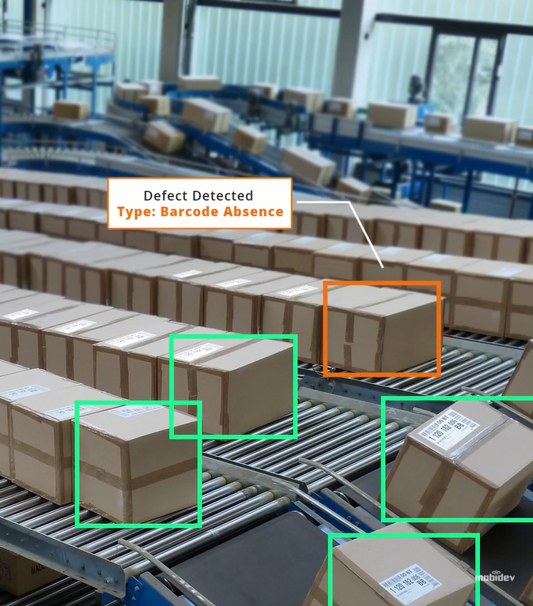
Limitations
roller speed capture
Multi-object handling
Upgrades
Object tracking
Detect the position of the error

Slide 34


Related Work
CV-BASED POTATO DEFECT DETECTION
90%
Defect Detection with SVM and ANN.
Results have lesser accuracy. Low Performance.
AI DEFECT DETECTION SYSTEM
Results have high accuracy. High Performance. Low Cost.
99%
99%
QualitasTech QA System
More expensive.

Slide 35
Thank you ! Any Questions?

